Slide 1

CORE OUTCOME MEASURES FOR IMPROVING DEMENTIA CARE

Slide 2
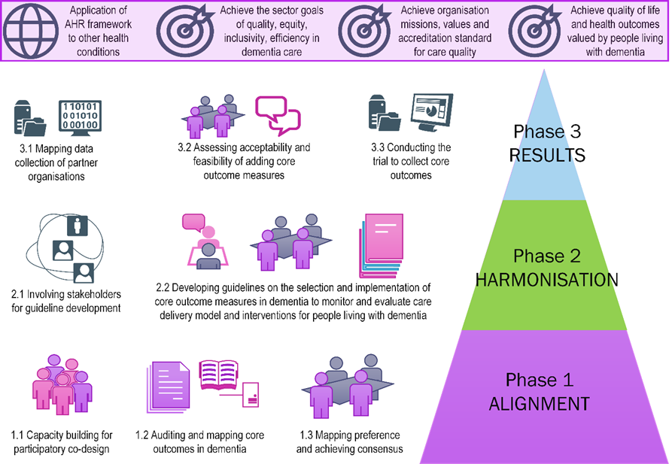
In the beginning…

Slide 3
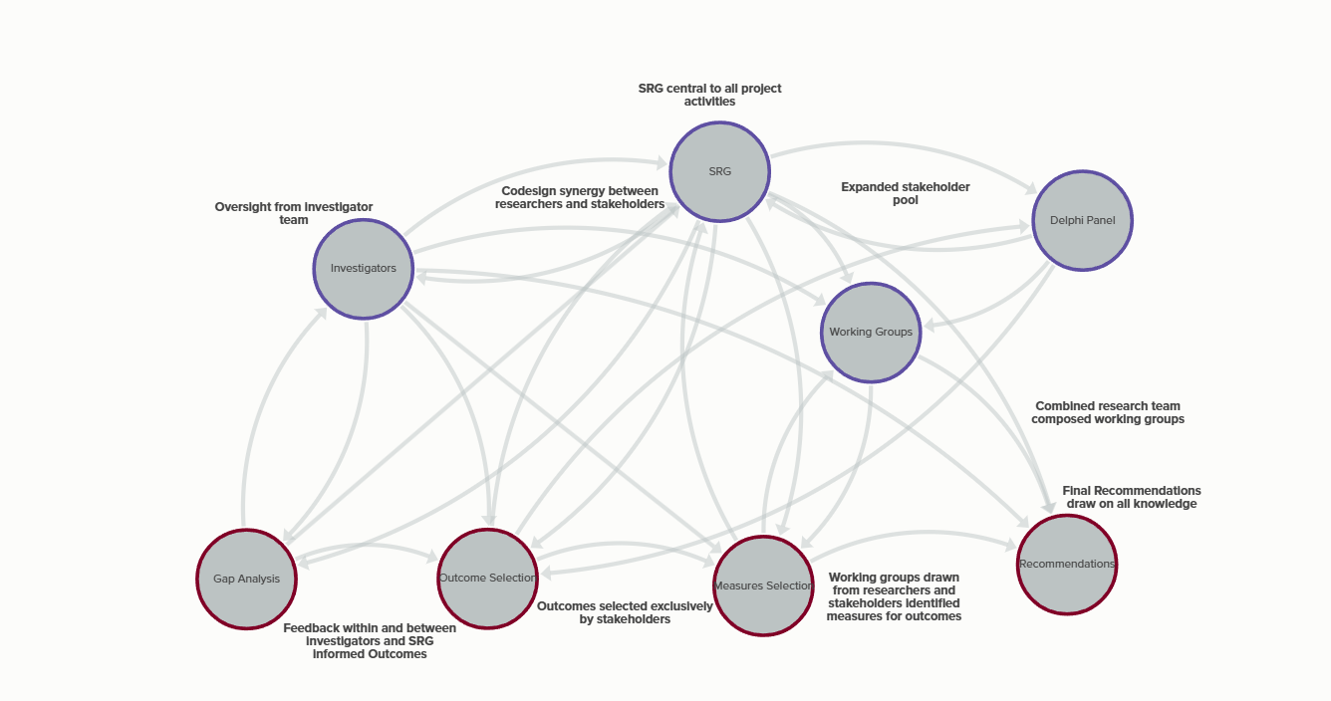
Our Pathway(s)

Slide 4
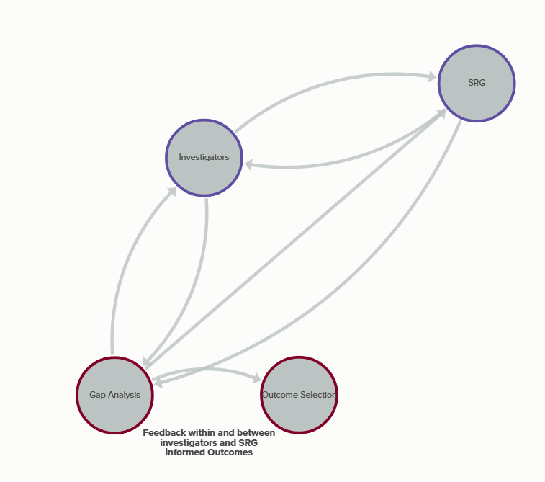
Gap Analysis
Stakeholders
Industry
COMET
Outcomes List

Slide 5
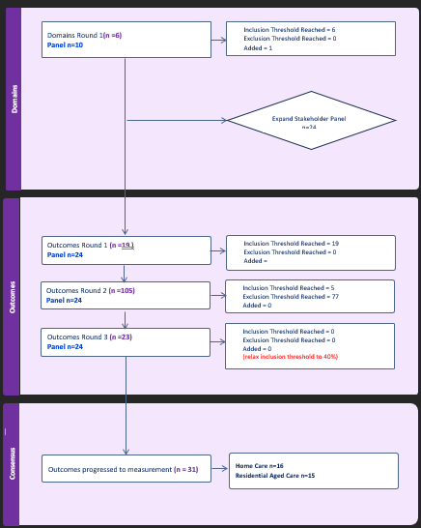
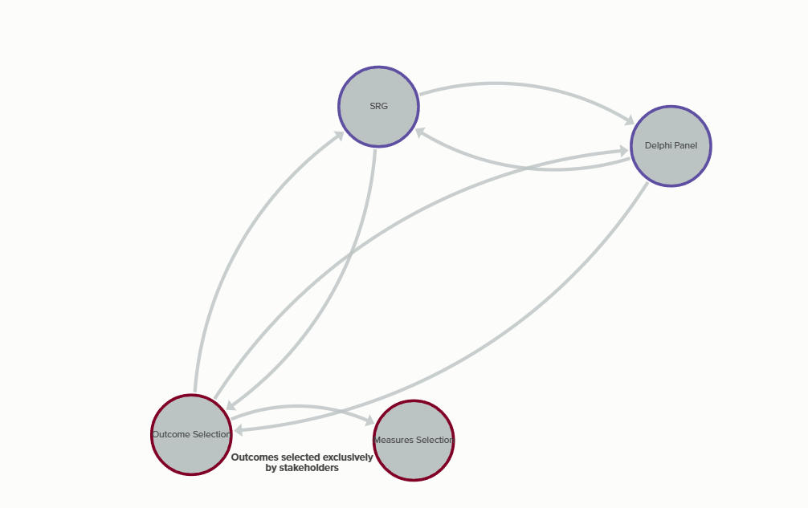
Outcome selection

Slide 6
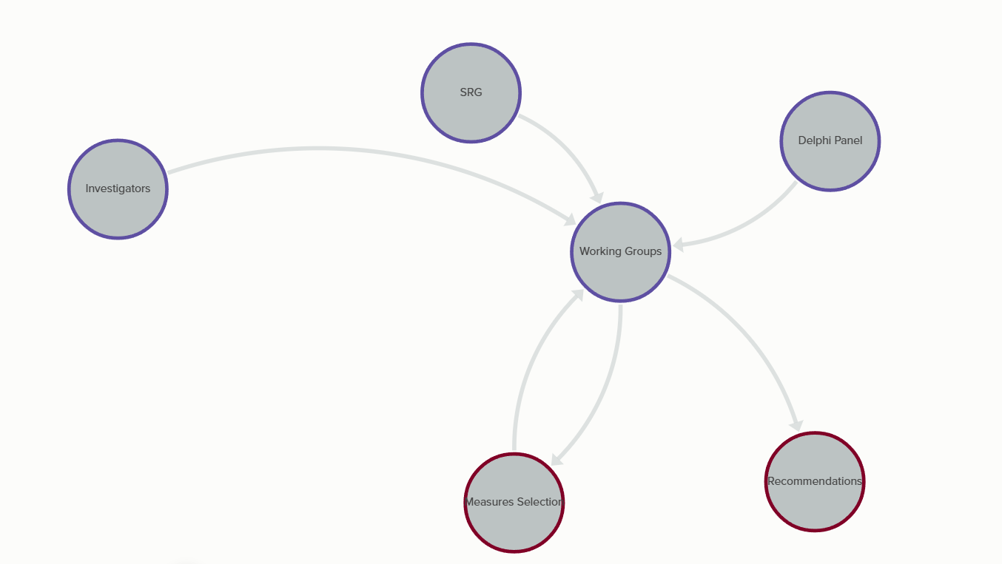
Working Groups

Slide 7
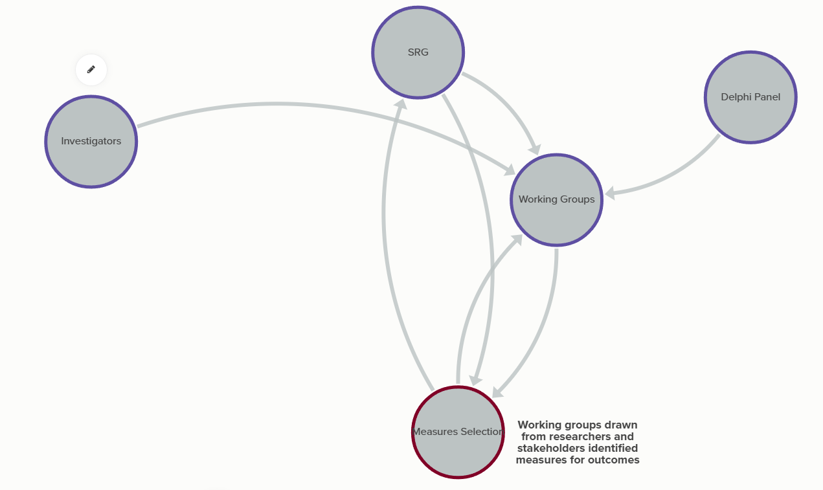
Outcome measures

Slide 8
Recommendations | Plain language definition | Target audience
Identified core outcome measures be implemented by service providers as a minimum standard of care quality audit. | There are five ways of measuring components of quality dementia care that are important to people experiencing dementia in home and residential care settings. These measures can be used immediately by service providers to improve quality of dementia care in these settings. | This recommendation is directed at the Australian Government agencies responsible for aged care policy and regulation.
Further research is required to develop and validate appropriate measurement instruments directed at the outcomes highlighted by stakeholders as being core to quality care provision (i.e., suggested outcomes). | Further research is needed to find better ways of measuring some additional components of quality care that are important to people experiencing dementia. | This recommendation is directed at the MRFF, university researchers and others in a position to contribute.
Validated measures for outcomes not considered core should be made available for service providers with an interest in improving quality of dementia care in those areas. | Other components of quality care were considered less critical to people experiencing dementia in home and residential care settings, however, suitable measures for these components are available and can be used by service providers with an interest in improving the quality of dementia care. | This recommendation is directed at aged care service providers willing and able to take additional innovative steps against which other providers might benchmark best practice over time.
Outcomes identified as important but not core should be discussed as potential areas for care quality improvement in home care and residential aged care settings. These items may be considered core items in future. | Components of care considered less important at the time research was conducted should be reconsidered as a potential focus in future reviews of quality improvement initiaitives. | This recommendation is directed at government policy and regulatory agencies, university researchers, peak authorities for aged care and dementia care, dementia advocacy groups, conference organisers and interested others.
Core outcome measures for improving care for people experiencing dementia in home care and residential aged care should be reviewed periodically for relevance and currency. | Improving the care of people experiencing dementia in home care and residential aged care settings requires ongoing periodical reviews incorporating perspectives of stakeholder groups in the pursuit of meeting evolving societal expectations of quality health care. | This recommendation acknowledges our understanding of dementia and associated sequelae are constantly evolving and it stands to reason that our ability to measure and subsequently improve quality of care needs to evolve concurrently.

Slide 9
Recommendation 1
Identified core outcome measures be implemented by service providers as a minimum standard of care quality audit.
There are five ways of measuring components of quality dementia care that are important to people experiencing dementia in home and residential care settings. These measures can be used immediately by service providers to improve quality of dementia care in these settings.
This recommendation is directed at the Australian Government agencies responsible for aged care policy and regulation.

Slide 10
Core Outcome Set for Routine Dementia Care
Outcome | Definition | Measure | Setting
Dignity | Experience of being treated with respect | QCE-ACC | HC
Hygiene | Conditions and practices around cleanliness | Barthel | HC
Dignity | Experience of being treated with respect | QCE-ACC | RAC
Pain | Pain should be attended to with respect and monitored/managed at all time points | PAINAD | RAC
Meaningful Activities | Preserve the right for people experiencing dementia to engage in activities that develop connections and develop a sense of meaning or purpose that align with the care recipient’s values, sense of accomplishment, and overall positive affect. | EMAS | RAC

Slide 11
Recommendation 2
Further research is required to develop and validate appropriate measurement instruments directed at the outcomes highlighted by stakeholders as being core to quality care provision (i.e., suggested outcomes).
Further research is needed to find better ways of measuring some additional components of quality care that are important to people experiencing dementia.
This recommendation is directed at the MRFF, university researchers and others in a position to contribute.

Slide 12
Core Outcomes Without Measures
Outcome | Definition | Measure | Setting
Diagnosis of Dementia | Accurate diagnosis (and aetiology) of dementia. | MoCA | HC
Feeling Safe and Secure | Feeling psychologically safe, including not being punished or humiliated for sharing ideas, asking questions, voicing concerns, or making mistakes. | NPSS | HC
Quality of Life | Experience of health and well-being. | QOL-AD | HC
Dementia Qualifications | All professional care staff providing care to people living with dementia should have an understanding of the condition, its manifestation, and appropriate responses to provide care with respect and dignity. | DKAS | HC
Hygiene and Comfort | Two separate concepts: Hygiene – conditions or practices conducive to maintaining health and preventing disease, especially through cleanliness. Comfort – transient, multi-dimensional state that is free from pain, including psychological distress. | COMFORT | RAC
Emotional Wellbeing | Supporting people experiencing dementia to realise their potential, cope with normal stress, work productively, and contribute to their community. | WHO-5 | RAC
Quality of Life | The standard of health, comfort, and happiness experienced by an individual or group. | QOL-AD | RAC
Adverse Events | Prevention, monitoring and tracking of harmful or negative outcomes occurring during provision of medical care. | NRM | RAC
Dementia Qualifications | All professional care staff providing care to people living with dementia should have an understanding of the condition, its manifestation, and appropriate responses to provide care with respect and dignity. | DKAS | RAC

Slide 13
Recommendation 3
Validated measures for outcomes not considered core should be made available for service providers with an interest in improving quality of dementia care in those areas.
Other components of quality care were considered less critical to people experiencing dementia in home and residential care settings, however, suitable measures for these components are available and can be used by service providers with an interest in improving the quality of dementia care.
This recommendation is directed at aged care service providers willing and able to take additional innovative steps against which other providers might benchmark best practice over time.

Slide 14
Extended Outcome Set for Routine Dementia Care
Outcome | Definition | Measure | Setting
Behavioural Symptoms of Dementia | Behavioural and psychological symptoms need to be charted, with changes documented | NPI | HC
Meaningful Activities | Preserve the right for people experiencing dementia to engage in activities that develop connections and develop a sense of meaning or purpose that align with the care recipient’s values, sense of accomplishment, and overall positive affect. | EMAS | HC
Family/Carer Quality of Life | Supporting main caregivers to maintain their own health and wellbeing to sustain appropriate care-giving arrangements in the home. | ZBI | HC
Neuropsychiatric Symptoms of Dementia | Neurological and psychological symptoms of dementia need to be charted, managed, and documented as part of routine care. | NPI | RAC
Staff Carer Morale | Acknowledgement that high quality care can only be attained with an engaged, valued, and supported workforce. | MAGPI | RAC

Slide 15
Recommendation 4
Outcomes identified as important but not core should be discussed as potential areas for care quality improvement in home care and residential aged care settings. These items may be considered core items in future.
Components of care considered less important at the time research was conducted should be reconsidered as a potential focus in future reviews of quality improvement initiatives.
This recommendation is directed at government policy and regulatory agencies, university researchers, peak authorities for aged care and dementia care, dementia advocacy groups, conference organisers and interested others.

Slide 16
Extended Outcomes Without Measures
Outcome | Definition | Measure | Setting
Opportunities for unpaid carers | Carers are supported with resources and clinical education they need to learn about aspects of dementia care they can assist with. | NRM | HC
Advanced Care Planning | The opportunity to discuss and make an Advanced Care Plan | ACP Survey | HC
Importance of Relationships | Providing people experiencing dementia the freedom to express emotions and adapt to change, to flourish, feel connected, have a sense of purpose and agency, and a positive sense of self. | CARE | HC
Emotional Wellbeing | Supporting people experiencing dementia to realise their potential, cope with normal stress, work productively, and contribute to their community. | WHO-5 | HC
Resource Utilisation | Facilitate high level decision-making and efficient allocation of resources to be able to appropriately cost and budget for quality improvement activities | RUD-LITE | HC
Dementia Care Navigation | Developing partnerships between stakeholders to navigate complex health care systems and treatment landscapes. | Pathway | HC
Safety Incidents | Unplanned or unintended event or circumstance which could have resulted or did result in harm to a care recipient | NRM | HC
Advanced Care Planning | The opportunity to discuss and make an Advanced Care Plan | ACP Survey | RAC
Feeling Safe and Secure | Feeling psychologically safe, including not being punished or humiliated for sharing ideas, asking questions, voicing concerns, or making mistakes. | NPSS | RAC
Medication Appropriateness | Increased awareness and appropriate use of medication prevents adverse events associated with polypharmacy, reduces costs, and improves clinical care outcomes. | STOPP-START | RAC
Resource Utilisation | Facilitate high level decision-making and efficient allocation of resources to be able to appropriately cost and budget for quality improvement activities. | RUD-LITE | RAC
Safety Incidents | Unplanned or unintended event or circumstance which could have resulted or did result in harm to a care recipient. | NRM | RAC

Slide 17
Recommendation 5
Core outcome measures for improving care for people experiencing dementia in home care and residential aged care should be reviewed periodically for relevance and currency.
Improving the care of people experiencing dementia in home care and residential aged care settings requires ongoing periodical reviews incorporating perspectives of stakeholder groups in the pursuit of meeting evolving societal expectations of quality health care.
This recommendation acknowledges our understanding of dementia and associated sequelae are constantly evolving and it stands to reason that our ability to measure and subsequently improve quality of care needs to evolve concurrently.

Slide 18
Where we’re going

Slide 19
Research
Delphi Paper - submitted
Rapid Review –submitted
Review of Stakeholder Engagement – under development
Recommendations – final editing
COM-IC evaluation – under development
HRSAANZ24 – Technology to support participatory action research short oral presentation 4th December
ISPOR Worskhop – application under development
Grant application to develop and validate measures for core outcomes without consensus on measurement – under development
Conference Abstract – ADI26
Conference Abstract – AAG25

Slide 20
Industry
Feasibility/ pilot work
Grant collaboration
Updates to website

Slide 21
Policy
Submission of recommendations to Dementia Awareness and Engagement unit
Continuation of work on Quality Indicator Program and update of Quality Care Standards

Slide 22
Community
Continuing collaboration with Dementia Australia – particularly on education outcomes and measures
Continuation of SRG input as consultants
Continued connection to UQ through DFUI

Slide 23
Thank you for your support and ongoing contribution to the COM-IC project
Congratulations and stay in touch!
University of Queensland
Centre for Health Services Research
E-mail: com-ic.study@uq.edu.au
Web: https://chsr.centre.uq.edu.au/com-ic
Linkedin: www.linkedin.com/in/danellekenny
P.S. MAKE SURE YOU FILL IN THE POST PROJECT EVALUATION ON QUALTRICS SO WE HAVE FULL DATA TO REPORT OUR GREAT WORK!!!

